Slide 1

NLP PROJECT

Slide 2
GROUP 5
ESHWAR
NANDA KRISHNA
DHRUVA NITHIN
SHASHIDHAR
BHANU PRAKASH
VIVEK
RUSHIKESH
MENTOR NAME:-
BHANU PRIYA

Slide 3
OBJECTIVE
Create a smart system using fancy language skills to tell apart fake and real news stories. We'll collect lots of news articles, tidy them up, and teach the system to spot the differences. We'll try different methods, like logistic regression or deep learning, to see which works best. Then, we'll fine-tune the system until it gets really good at its job. The end goal? A user-friendly tool that helps people quickly identify fake news, making it easier to navigate the messy world of information.

Slide 4
Exploratory Data Analysis
After the concatenating it consists of 44878 rows and 4 columns
We have performed some ed analysis
A)Describing the dataset
Our Dataset consists of 44878 rows and 4 columns
B)Cleaning the data
Considering this dataset we assumed that the date column are not needed. So
. we have dropped this columns.
C)Checking invalid records
We checked the dataset, and we found some invalid records
D)Missing value detection and imputation
We detected some missing values in the dataset and imputed with suitable code.
E)Duplicated records
We detected duplicate records in dataset we remove the duplicate records

Slide 5
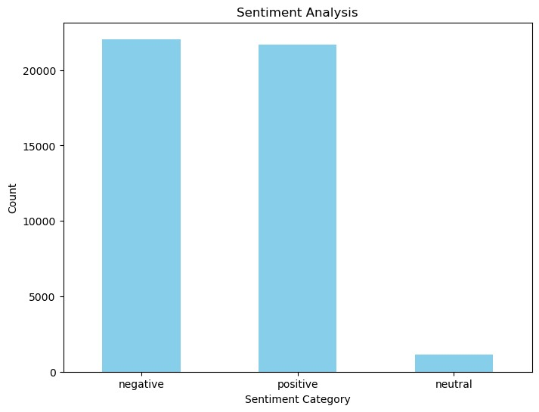
DATA VISUALIZATION Sentiment Analysis
This graph shows the Sentiment Analysis of the positive, negative and neutral comments
Where the negative comments is slightly more than positive comments
The positive comments is less than negative comments in the count of above 20000
Neutral comments are less than 5000

Slide 6
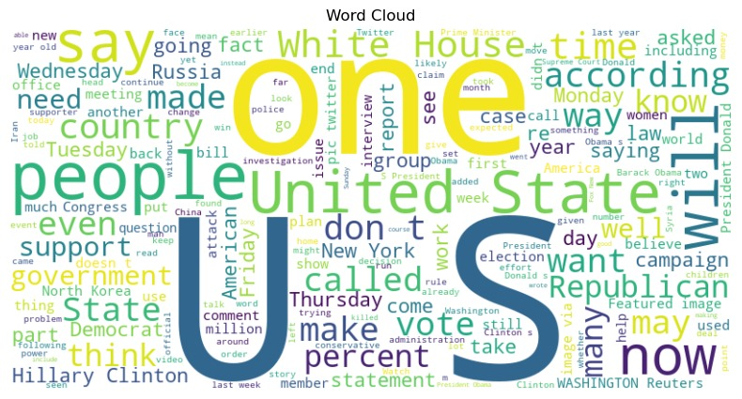
Word cloud
It shows the word cloud of true and fake data sets
A word cloud is a graphical representation of text data, where words are displayed in varying sizes based on their frequency. Commonly used words appear larger, while less frequent ones are smaller. It provides a quick visual summary of the most significant terms in a body of text, helping to identify key themes or topics at a glance.

Slide 7
Model building
Model name | CNN | Naïve bayes | Random forest | Logistic regression | SVM
Accuracy | 76.65% | 73.95% | 79.52% | 78.96% | 85.4%
MSE | 2.635
Negative precision |  | 0.73 | 0.80 | 0.79 | 0.87
Positive precision |  | 0.75 | 0.78 | 0.93 | 0.95
Neutral precision |  | 1.00 | 0.97 | 0.78 | 0.85

Slide 8
CONCLUSION
From the above modelling methods we have concluded that SVM classifier is a best method comparing with other modelling methods
Because SVM classifier is driving high accuracy comparing with other modelling methods

Slide 9
Challenges Faced
Communication: Effective communication is crucial for collaboration. Challenges may arise due to differences in communication styles, or language barriers. Establishing clear channels of communication
Coordination: Coordinating tasks and ensuring everyone is aligned with project goals can be challenging, especially when team members have different schedules or priorities. Using project management tools like Asana or Trello to assign tasks, track progress, and set deadlines can improve coordination and accountability.
Differing Skill Levels: Team members may have varying levels of expertise in data analysis techniques, programming languages, or domain knowledge. Providing opportunities for skill-sharing, training sessions, and mentorship can help bridge skill gaps and enhance the overall competency of the team.
Data Quality: The dataset may contain errors, inconsistencies, or missing values that can affect the accuracy of the analysis. For example, restaurant information may be incomplete or inaccurate, ratings may be inconsistent, or reviews may contain spam or irrelevant content.

Slide 10
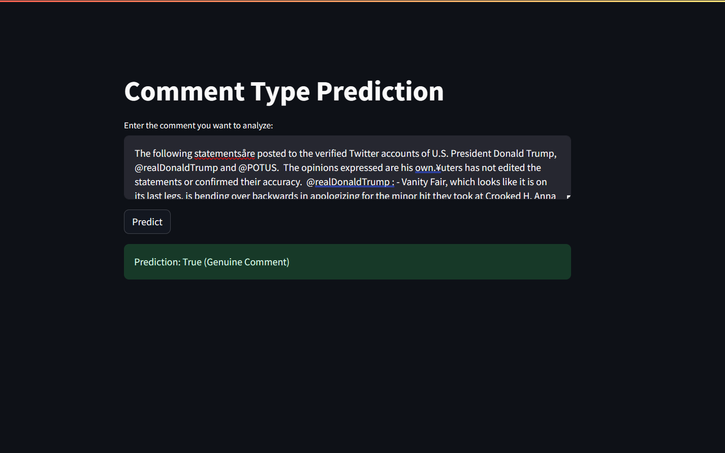
DEPLOYMENT
We Have Deployed SVM model by using Streamlit

Slide 11
THANK YOU

